Slide 1



Team 14
Bharath Bhaskar - 002849480
Riya Mate -002818432
IDENTIFYING PLANT DISEASES USING DISTRIBUTED DEEP LEARNING

Slide 2

INTRODUCTION TO PLANT DISEASES
SHODWE
Plant diseases have been a significant challenge throughout human history.
They greatly impact global agriculture and threaten food security.
Environmental concerns and population growth exacerbate the issue.
There is an urgent need for sustainable practices to manage plant diseases effectively.

Slide 3

PROJECT MOTIVATION
According to FAO, plant diseases cause a 20-40% reduction in global crop yields annually.
They result in significant economic losses, food scarcity, and environmental harm.
AI and image processing offer advanced solutions for disease monitoring and management.
The aim is to reduce chemical use by enabling precise and accurate disease detection.

Slide 4


SHODWE
PROJECT GOALS & OBJECTIVES
Create a cutting-edge plant disease detection system utilizing PyTorch.
Utilize multiprocessing to optimize data processing and inference efficiency.
Focus on achieving scalable and accurate high-performance detection.
Support proactive disease management while promoting environmental sustainability.

Slide 5
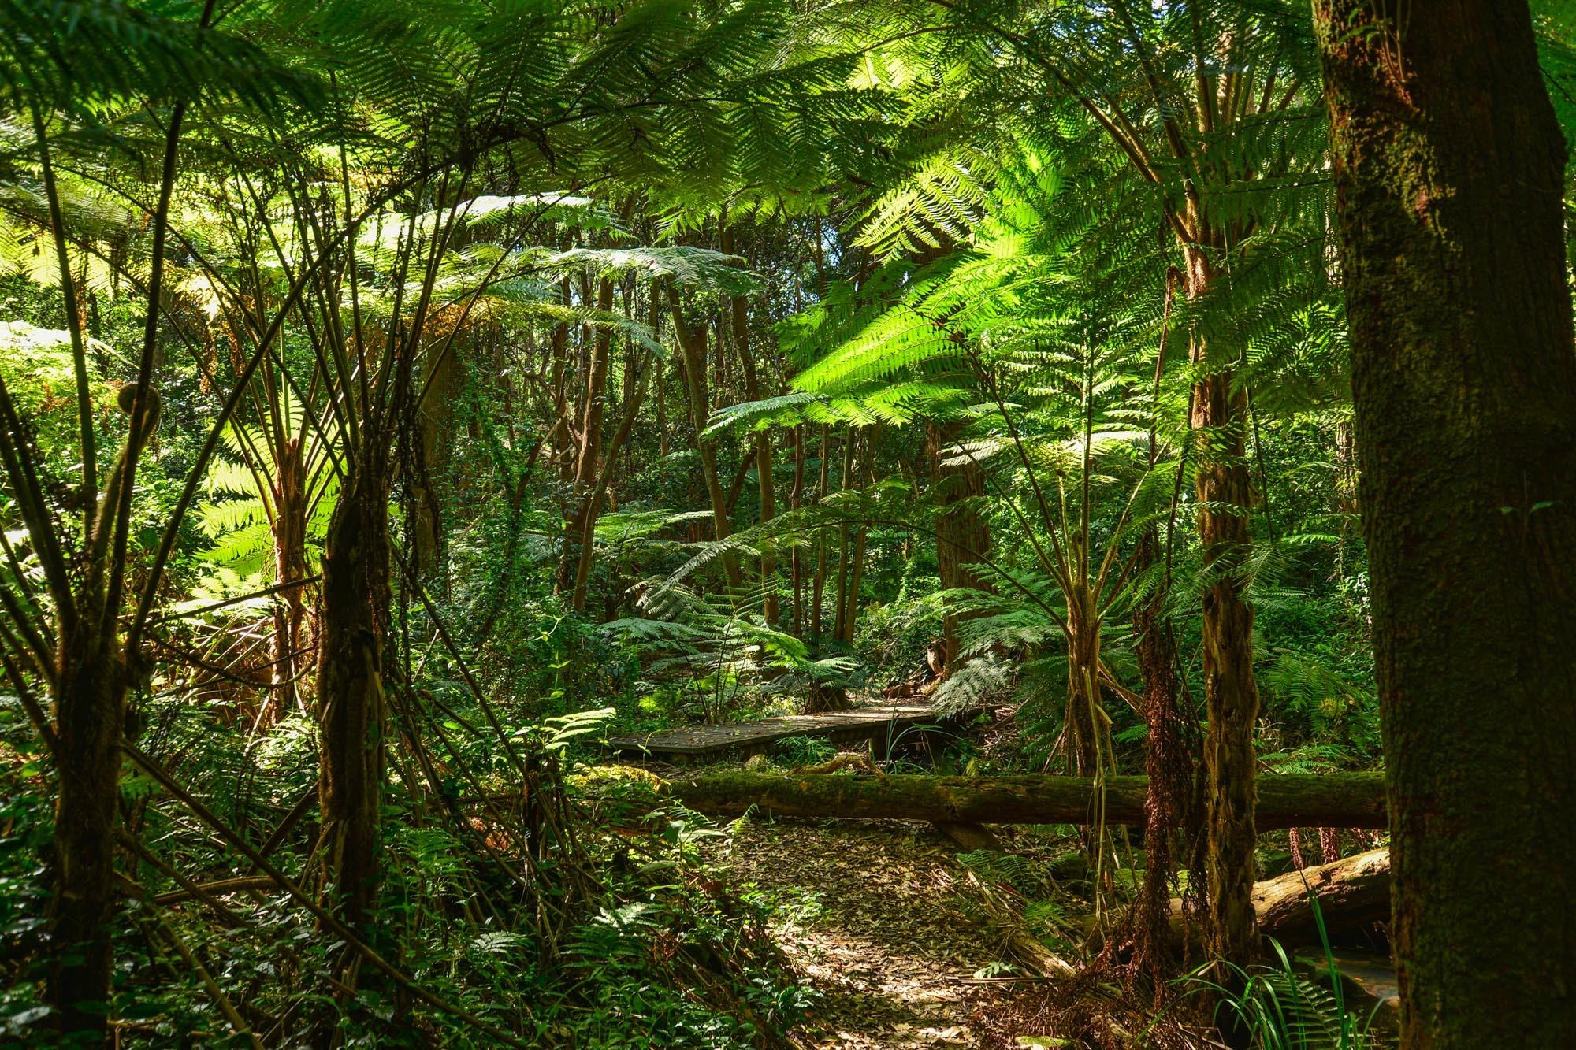
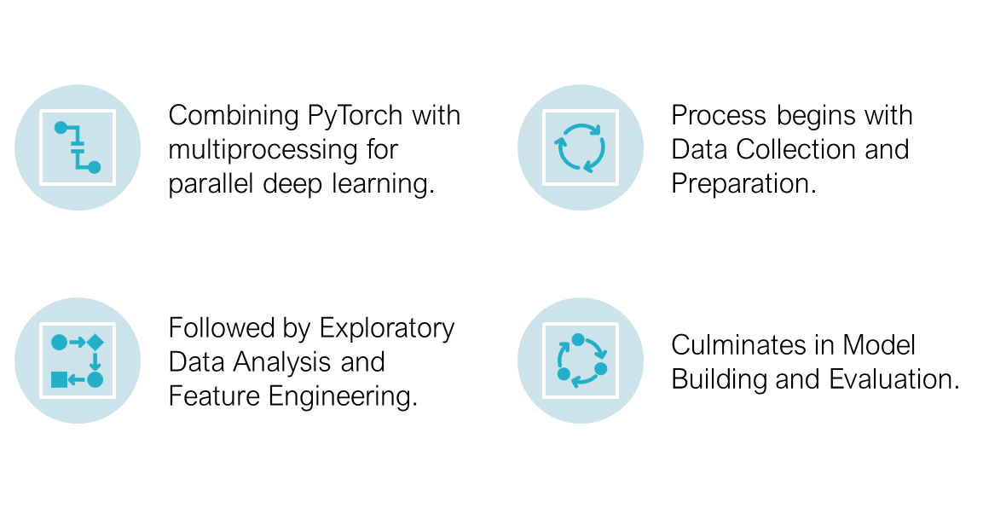
METHDOLOGY

Slide 6
DATA COLLECTION
Utilized libraries like PyTorch, NumPy, Pandas for data analysis and manipulation.
Image processing with PIL, torchvision.transforms for data augmentation.
Ensured quality and readiness of dataset for deep learning models.
Employed Tesla V100-SXM2-32GB GPU for computational efficiency.

Slide 7
DATASET DESCRIPTION
A 5.91 GB dataset containing 95,900 images across various plant species.
Includes a wide range of disease types such as fungal, bacterial, and viral infections.
Features a diverse selection of crops, from tomatoes to apples, ensuring broad applicability.
Curated from multiple sources to enable comprehensive analysis.

Slide 8
EXPLORATORY DATA ANALYSIS
Developed custom functions to classify unique plant species and infection types.
Conducted analysis to explore the dataset's diversity and complexity.
Identified a comprehensive set of 18 plant species and 61 infection categories.
Exploratory Data Analysis (EDA) proved essential for feature engineering and model training.

Slide 9
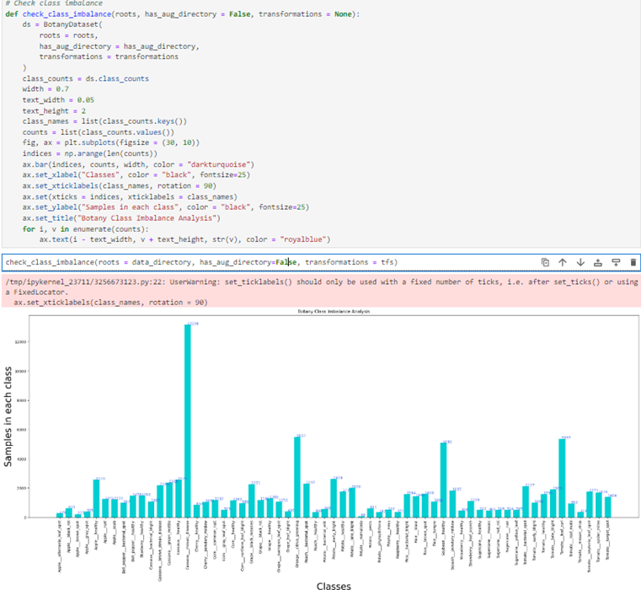
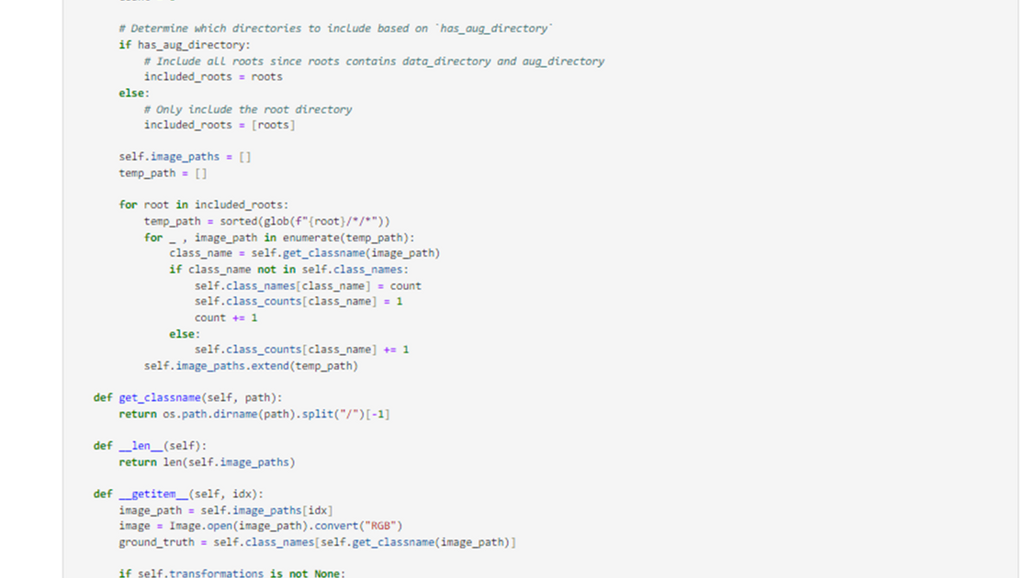
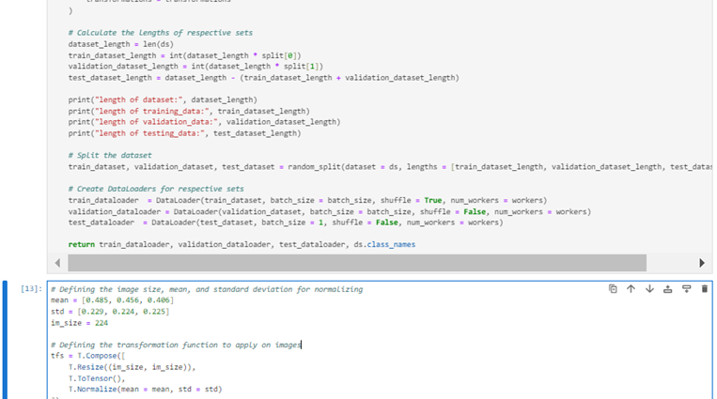

Slide 10
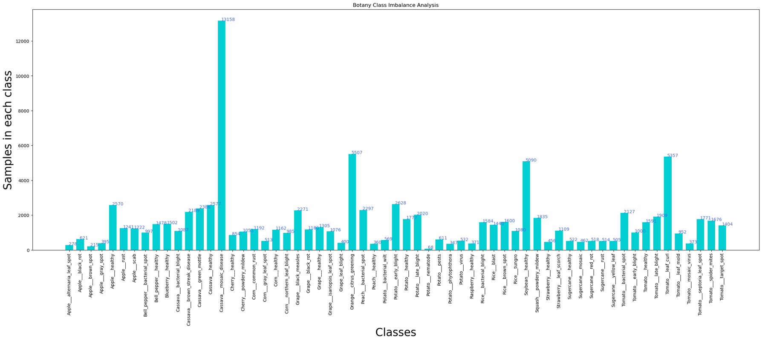

Slide 11
FEATURE ENGINEERING
Optimized data through feature engineering to enhance deep learning model performance.
Designed the model to achieve precise classification of botanical infections.
Struck a balance between efficiency and accuracy in model design and implementation.

Slide 12
DATA AUGMENTATION STRATEGIES
Optimized data through feature engineering to enhance deep learning model performance.
Designed the model to achieve precise classification of botanical infections.
Struck a balance between efficiency and accuracy in model design and implementation.

Slide 13
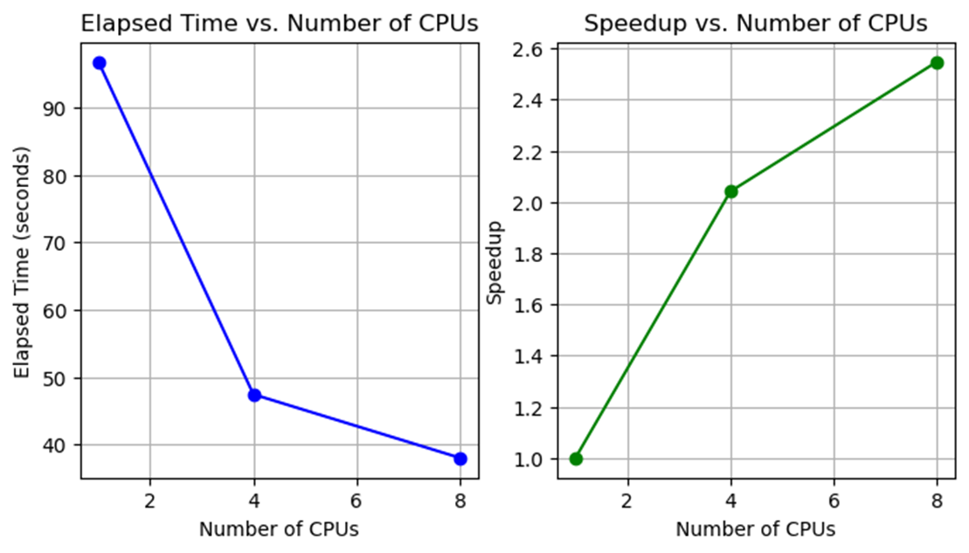
LEVERAGING MULTIPROCESSING FOR AUGMENTATION

Slide 14
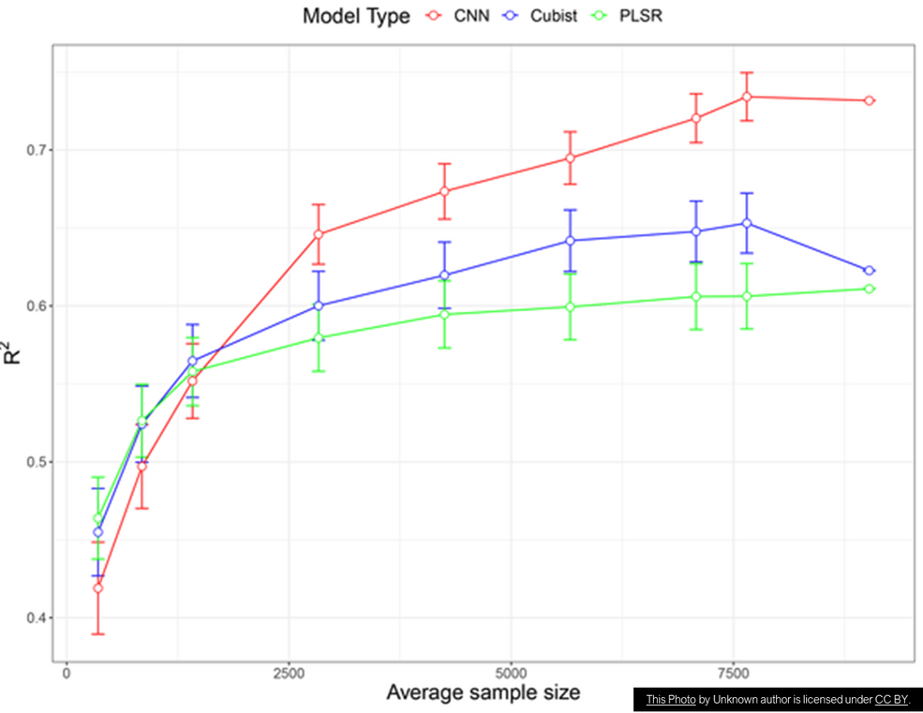
LEVERAGING MULTIPROCESSING FOR AUGMENTATION
Achieved exceptional accuracy in plant disease classification.
Improved computational efficiency by utilizing parallel processing techniques.
Effectively tackled class imbalance through data augmentation strategies.
Demonstrated the model's potential as a valuable tool for disease identification in agriculture.

Slide 15
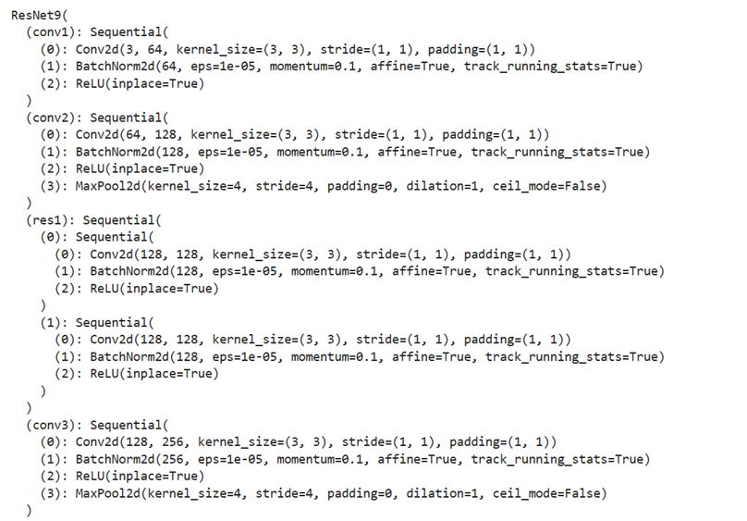
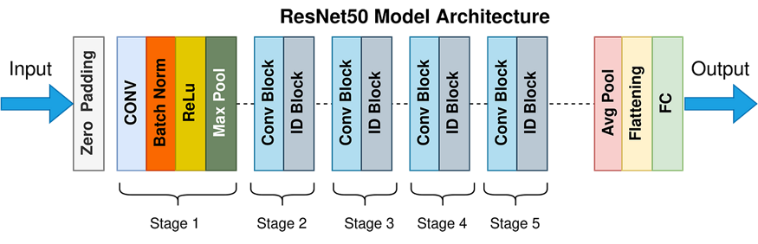
Model Building

Slide 16
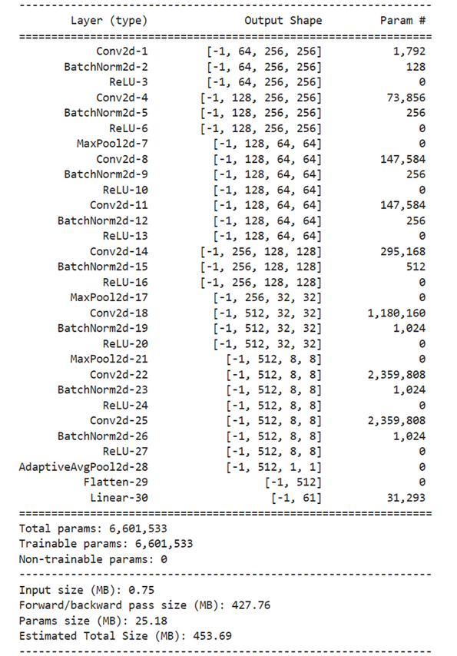
RESNET ARCHITECTURE

Slide 17
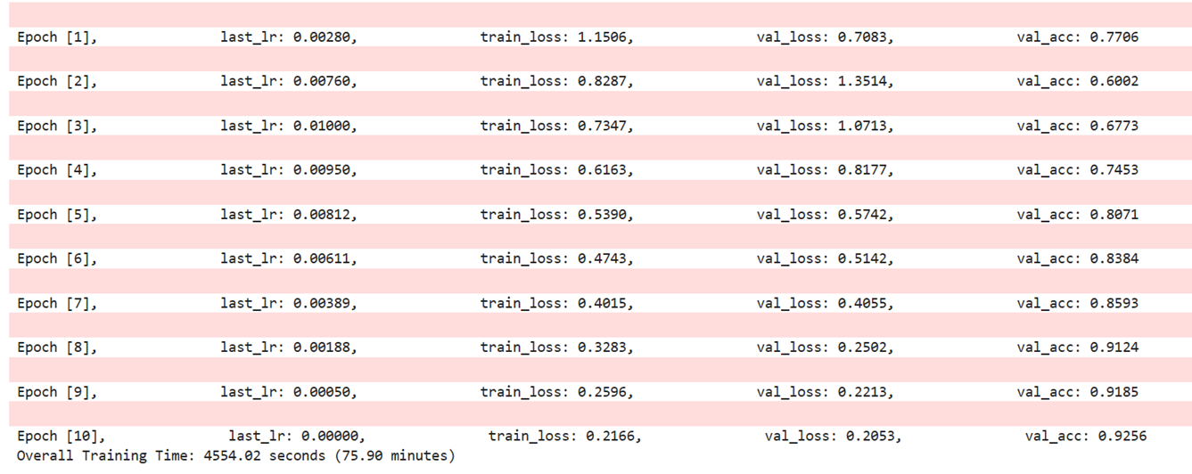
MODEL TRAINING

Slide 18
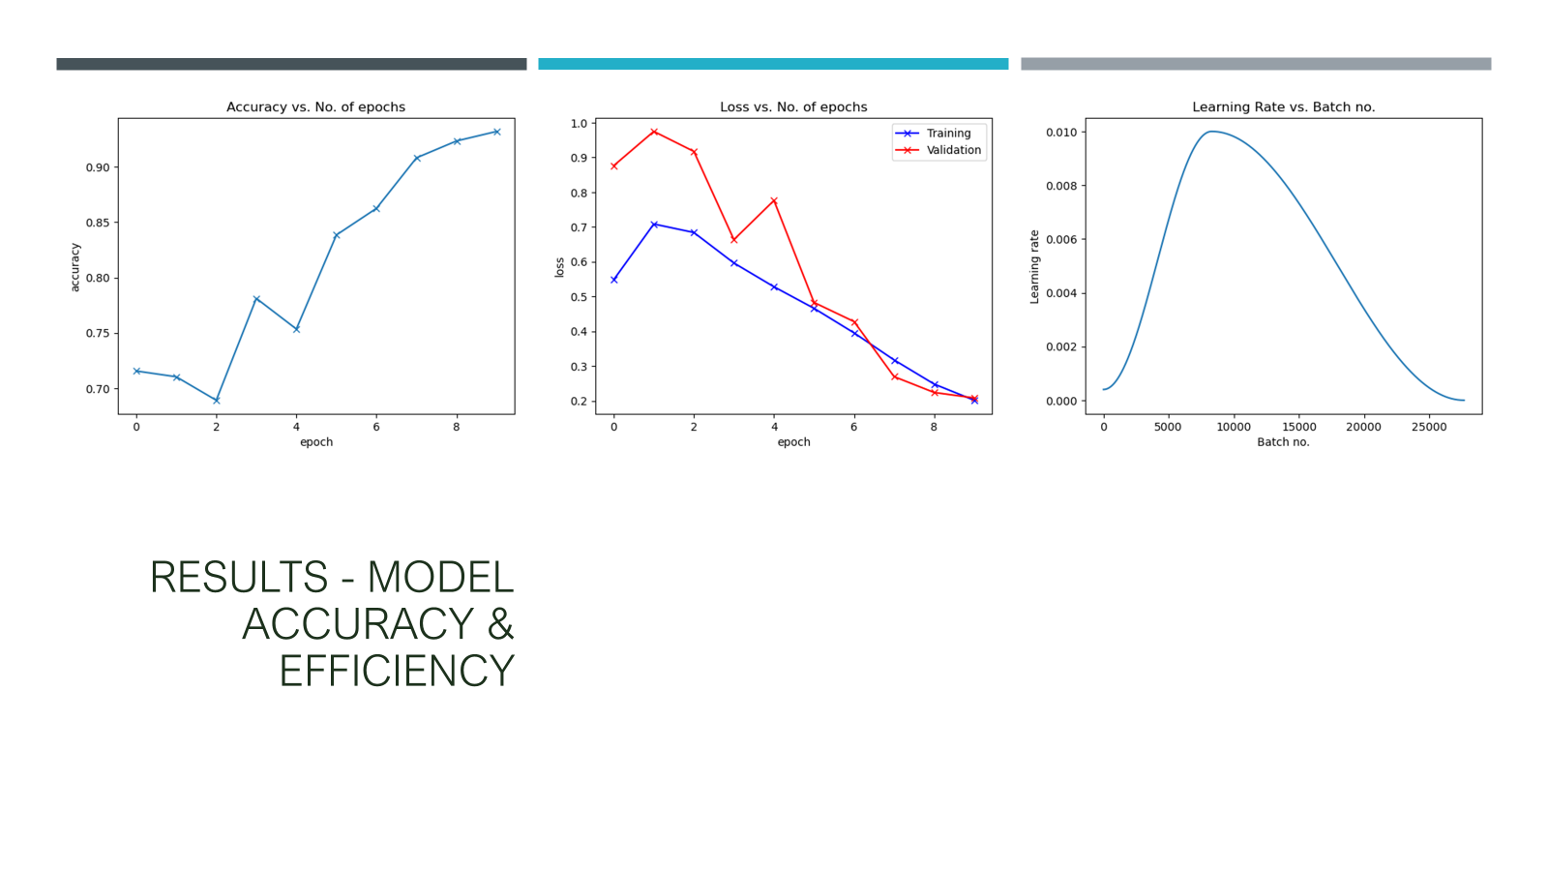

Slide 19
CONCLUSION
Achieved exceptional accuracy in plant disease classification.
Improved computational efficiency by utilizing parallel processing techniques.
Effectively tackled class imbalance through data augmentation strategies.
Demonstrated the model's potential as a valuable tool for disease identification in agriculture.

Slide 20

THANK YOU

